Slide 1
An Analytical Study on Predicting Customer Churn in the Telecommunications Sector: A Machine Learning Approach Using Data from an Iranian Telecom Company
IFEDOLAPO OLAOFE
B00913981
SCHOOL OF COMPUTING, ENGINEERING, AND INTELLIGECNCE SYSTEMS
UNIVERSITY OF ULSTER, MAGEE CAMPUS
DERRY, NORTHERN IRELAND

Slide 2
Contents.
01. AIM & OBJECTIVES
02. INTRODUCTION
03. DATA DESCRIPTION
04. METHODOLOGY
05. RESULT
06. DISCUSSION
06. CONCLUSION
07. REFERENCES

Slide 3

AIM & OBJECTIVE
Aim:
- To use machine learning approaches to anticipate customer attrition (churn) within an Iranian telecommunications company.
Objective:
- To analyze customer churn using data from the UCI Machine Learning Repository.
- To apply Logistic Regression and Random Forest as the primary machine learning classification techniques.
- To compare the performance of these models and identify which one more effectively predicts customer churn.
- To derive insights that will aid in the creation of effective client retention strategies in the competitive landscape of the telecommunications industry.

Slide 4
INTRODUCTION
Churn Prediction Overview
Identifying potential customer attrition [2].
Key in strategizing focused retention efforts [3].
Importance Across Industries
Impactful in telecom, banking, e-commerce, and more.
Addresses retention challenges in a tech-driven information era [4].
Study Objective
Predict customer churn in telecom using Logistic Regression and Random Forest.
Data sourced from UCI Machine Learning Repository [1].
Methodology and Insights
Application of exploratory data analysis (EDA) for business intelligence.
Aim to enhance corporate revenue through informed decision-making.

Slide 5
DATA DESCRIPTION
Dataset Source and Composition
Sourced from UCI Machine Learning Repository [1].
Contains 3150 customer records.
Key Attributes of the Dataset
Anonymous Customer ID.
Call Failures, Complains, Subscription Length.
Charge Amount: Ordinal (0-10 scale).
Usage Metrics: Seconds of Use, Frequency of Use, Frequency of SMS.
Distinct Called Numbers.
Age Group: Ordinal (1-5 scale).
Tariff Plan, Status.
Churn: Class label (1 for churn, 0 for non-churn).
Customer Value in Iranian Rial.
Data Preparation
Comprehensive data cleaning, normalization, and transformation.
Ensured data quality for EDA and predictive analysis.

Slide 6
METHODOLOGY
Methodological Overview
Combination of Exploratory Data Analysis (EDA) and Predictive Modeling.
Data cleaning: No missing values, transformation for deeper insights.
EDA Highlights
Churn Rate Analysis
Age Group Distribution
Age Group vs. Customer Value
Usage Trends by Age: Seconds of Use
Subscription Length's Impact on Churn
Subscription Length vs. Usage
Customer Complaints and Churn
Predictive Modelling Techniques
Logistic Regression: Ideal for binary classification; simple and interpretable [5].
Random Forest Classifier: Handles large, high-dimensional datasets effectively [6].
Evaluation Metrics
Accuracy, Precision, F1 Score: To ascertain model performance.

Slide 7
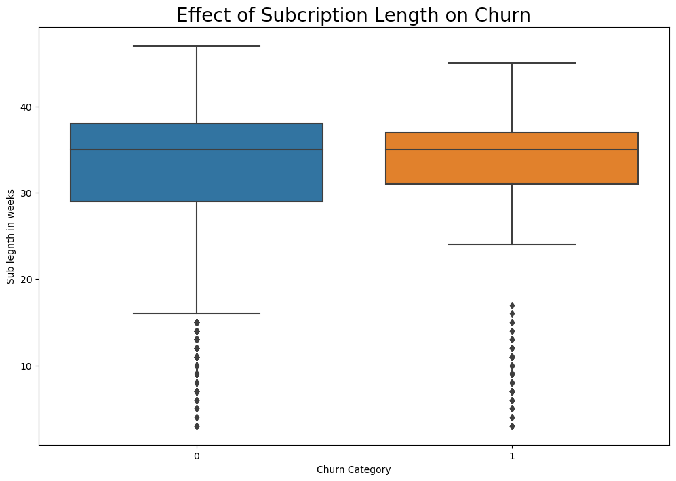
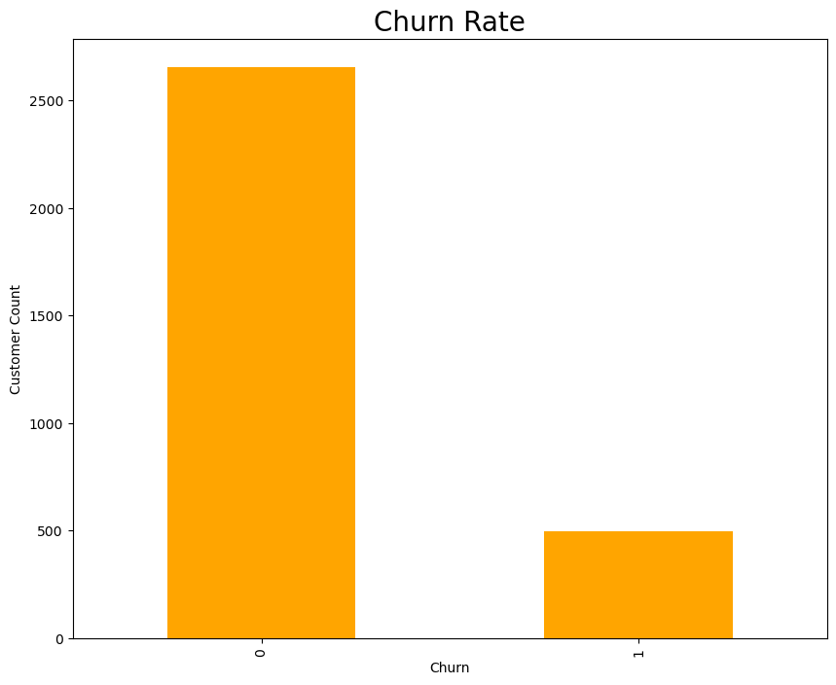
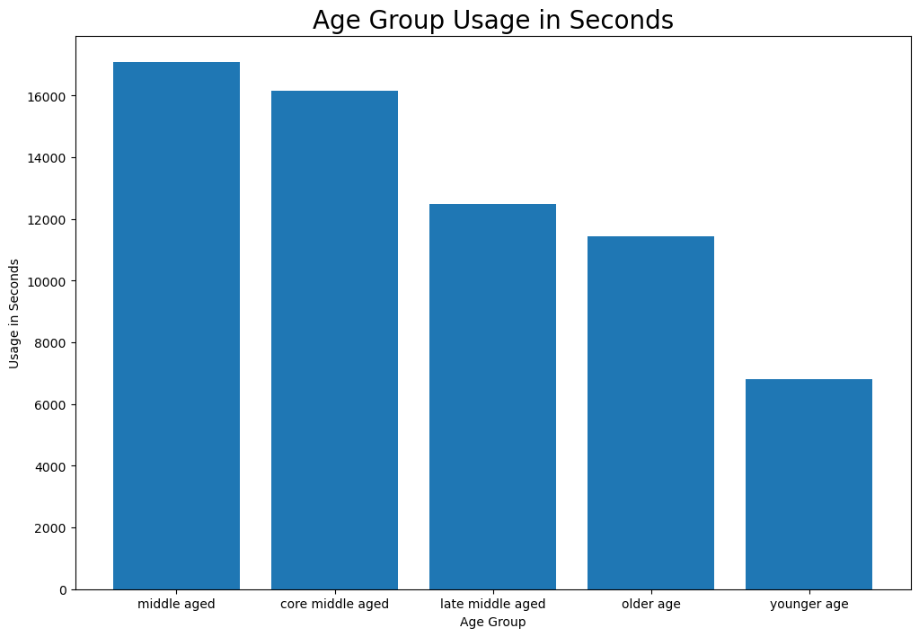
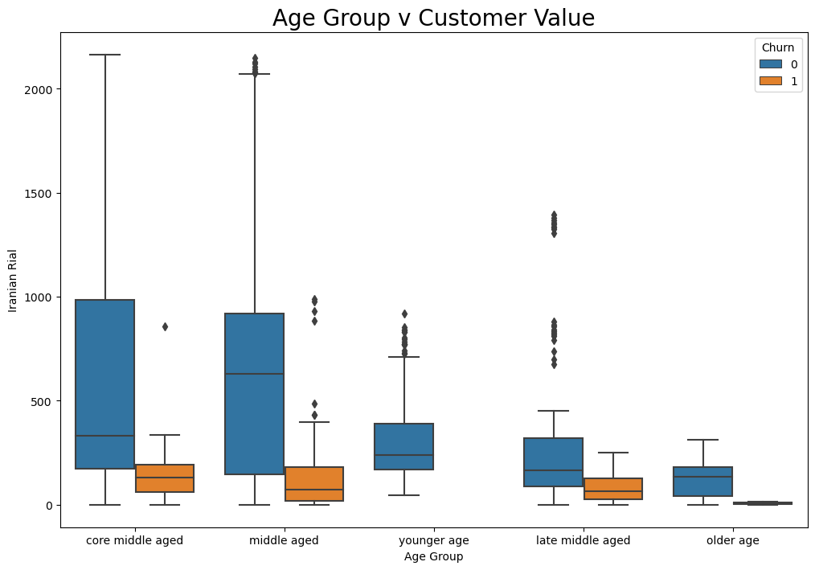
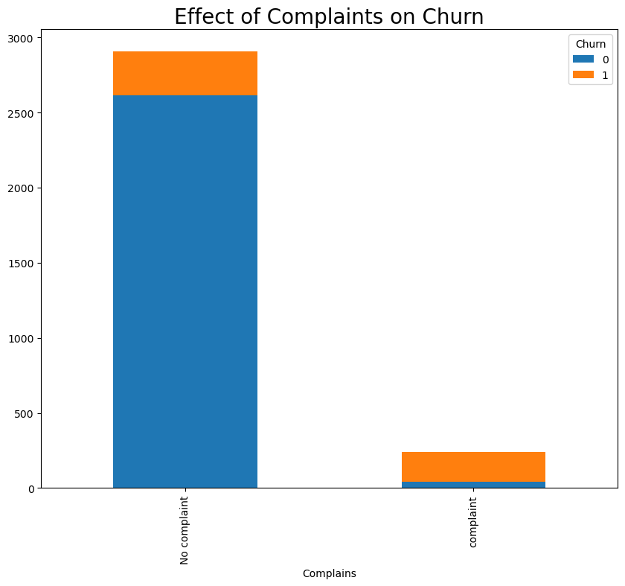
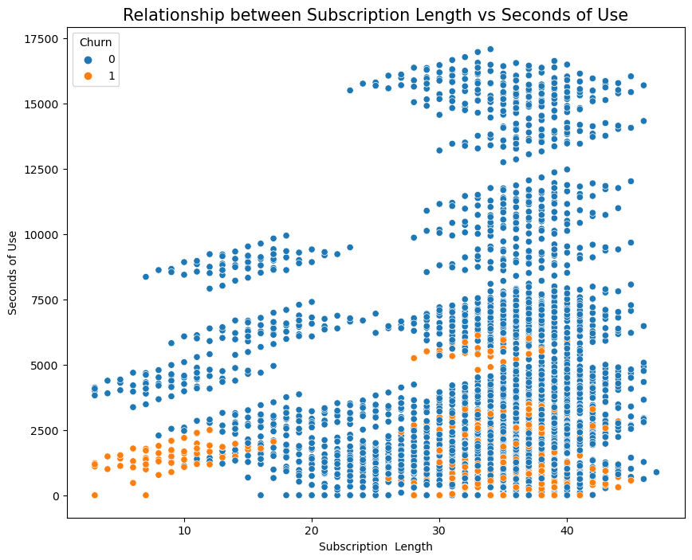
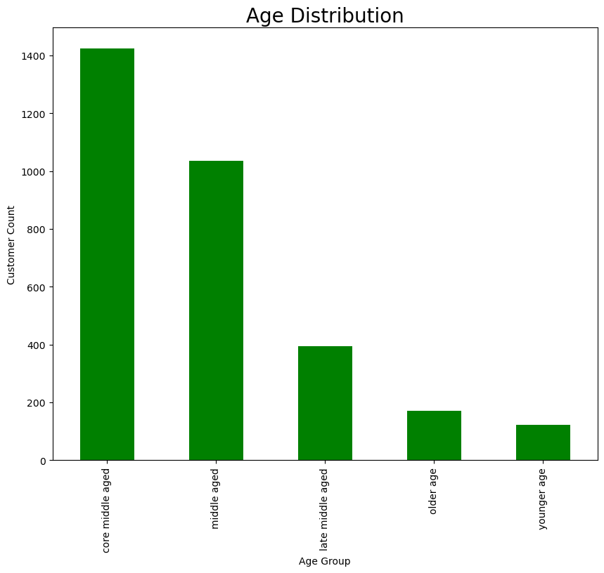
RESULT

Slide 8
RESULT
Model | Accuracy | Precision | Recall | F1 Score | ROC AUC Score
LR | 0.85 | 0.42 | 0.15 | 0.22 | .056
RF | 0.95 | 0.81 | 0.82 | 0.81 | 0.89

Slide 9
DISCUSSION.
Performance of Random Forest Model
Superior due to handling complex, non-linear relationships in the dataset.
Significance for Telecom Industry
Crucial for Iranian telecom companies combating high customer churn rates.
Study Limitations
Limited by the dataset's extent and inherent biases in the algorithms used.

Slide 10
CONCLUSION.
Research Summary
Demonstrates the use of machine learning in telecom customer churn prediction.
Key Model Performance
Random Forest excels in the Iranian telecom sector.
Offers actionable insights for improving client retention strategies.
Future Research Directions
Exploration of diverse machine learning models and datasets for broader applicability.
Comparative Model Analysis
Random Forest outperforms Logistic Regression in all metrics.
More accurate and effective in classifying churn and non-churn cases

Slide 11
REFERENCES.
"Churn Dataset." UCI Machine Learning Repository. Accessed 2023. [Online]. Available: https://archive.ics.uci.edu/datasets?search=churn
Coussement, K., & Van den Poel, D. (2008). Buckinx, W., & Van den Poel, D. (2005).
Hashmi, N., Butt, N. A., & Iqbal, M. (Year). "Customer Churn Prediction in Telecommunication: A Decade Review and Classification." Department of Computer Science and Information Technology, Faculty of Computer Science and Information Technology, University of Gujrat, Pakistan.
Mahajan, V., Misra, R., & Mahajan, R. (2015). "Review of Data Mining Techniques for Churn Prediction in Telecom." Journal of Information and Organizational Sciences, vol. 37, no. 2
Hosmer Jr, D. W., Lemeshow, S., & Sturdivant, R. X. (2013). Applied Logistic Regression. John Wiley & Sons.
Breiman, L. (2001). Random Forests. Machine Learning, 45(1), 5-32.

Slide 12

Thank you

